Slide 1



SURESH GYAN VIHAR UNIVERSITY
GAOTEK INC
AUTOMATION PROJECT
PRESENTED BY SAMIR SRINATH
2347454
PYTHON PROJECT

Slide 2

INTRODUCTION
GAOTek Inc. is a leading global supplier of test and measurement equipment, embedded computing systems, and advanced technologies. Founded in 1997, the company is headquartered in New York, Toronto, Canada, with offices and clients worldwide. GAOTek specializes in providing innovative, high-quality solutions for industries such as telecommunications, manufacturing, construction, and healthcare.
With a comprehensive product portfolio, GAOTek serves professionals and businesses with equipment ranging from fiber optics testers to environmental sensors. The company's commitment to excellence, technological innovation, and customer satisfaction has made it a trusted name in the tech industry.
PAGE 01

Slide 3
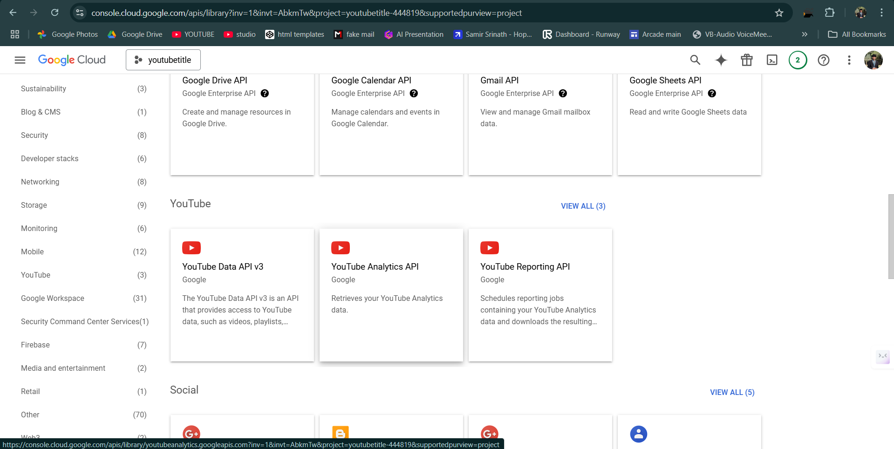
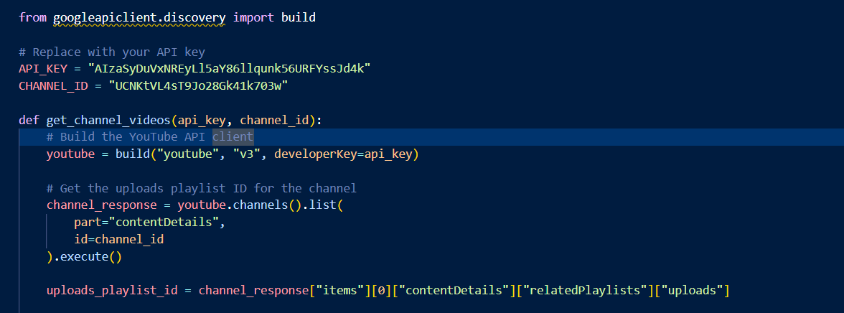
IDEA
Automation can make your work more easier and faster.
PAGE 02

Slide 4

PROJECT SCOPE
Automated Text Formatting:
Standardizes product names.
Adjusts hyphens for proper naming conventions.
Data Extraction:
Retrieves essential details: product name, ID, links, price, category, and meta description.
Excel Export with Hyperlinks:
Clickable links for ease of access to product and supplier information.
PAGE 03

Slide 5

KEY MILESTONES
PHASE 1:
PROBLEM IDENTIFICATION
PHASE 2:
EXTRACTING USEFUL DETAILS
PHASE 3:
FORMATTING TITLE AND BODY
PHASE 4:
UPLOADING ON THE GAOLAB
PHASE 5:
ACCURACY IMPROVEMENT
PAGE 04

Slide 6
PYTHON Library
DOCX: EXTRACTS AND PROCESSES TEXT FROM WORD DOCUMENTS.
RE: HANDLES TEXT PATTERN MATCHING, STRING FORMATTING, AND CLEANING (E.G., REMOVING HYPHENS, ADDING SPACES).
PANDAS: CONVERTS DATA INTO A DATAFRAME AND EXPORTS IT TO AN EXCEL FILE.
OPENPYXL: EDITS EXCEL FILES, ADDS HYPERLINKS, AND ENHANCES INTERACTIVITY IN THE OUTPUT.
PAGE 05

Slide 7
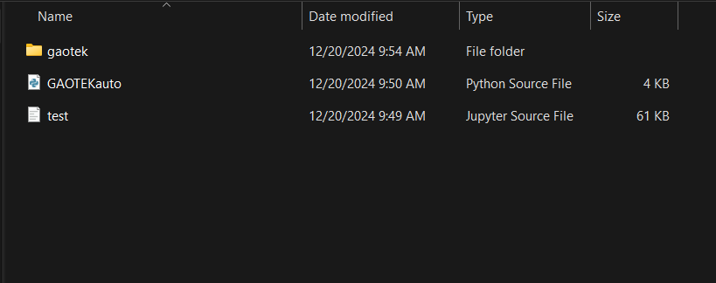
GUI
Click here
PAGE 06

Slide 8
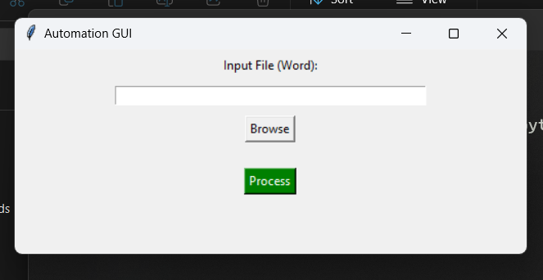
GUI
Enter the path of input word file
Or Browse the file
PAGE 07

Slide 9
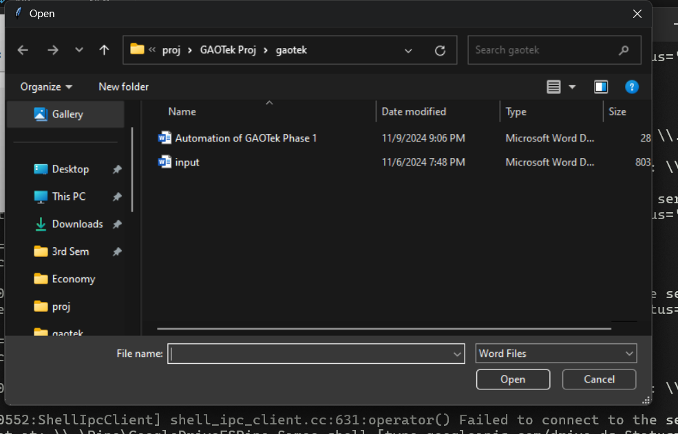
GUI
Select the file
Click Open
PAGE 08

Slide 10
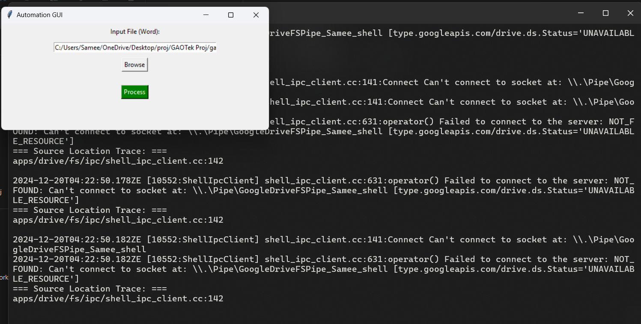
GUI
Selected path
Click on process
PAGE 09

Slide 11
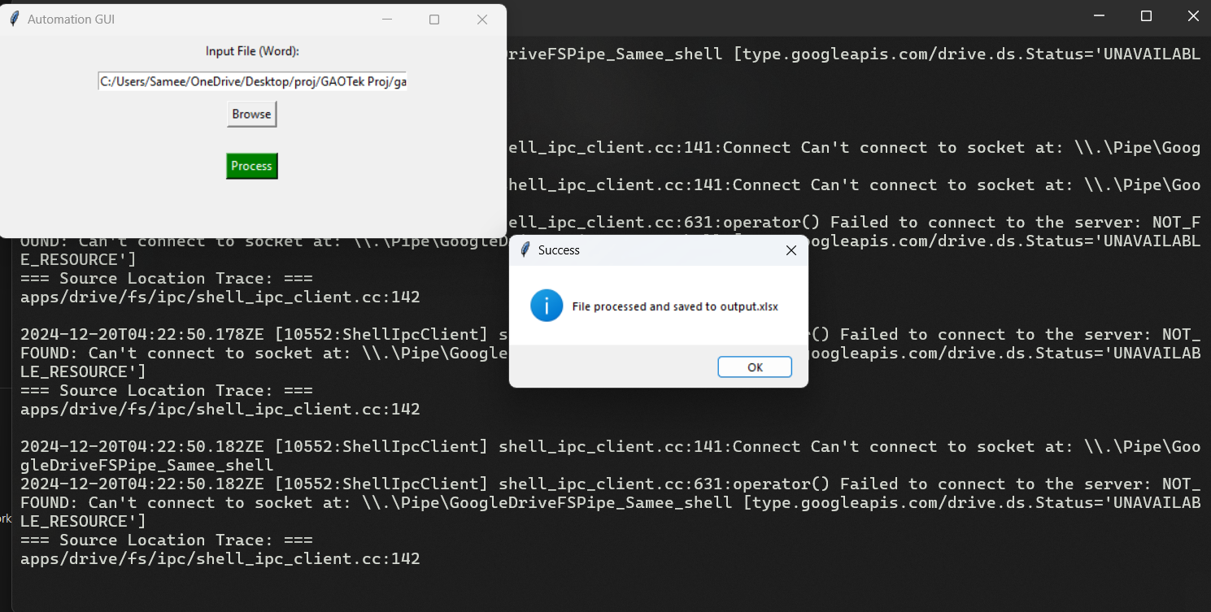
GUI
Completed Confirmation
PAGE 10

Slide 12
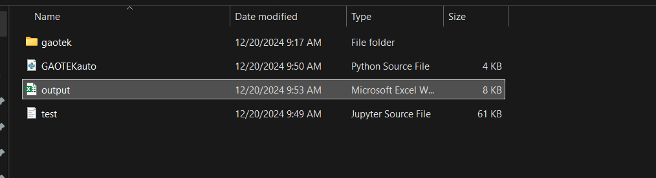
GUI
Output file
PAGE 11

Slide 13
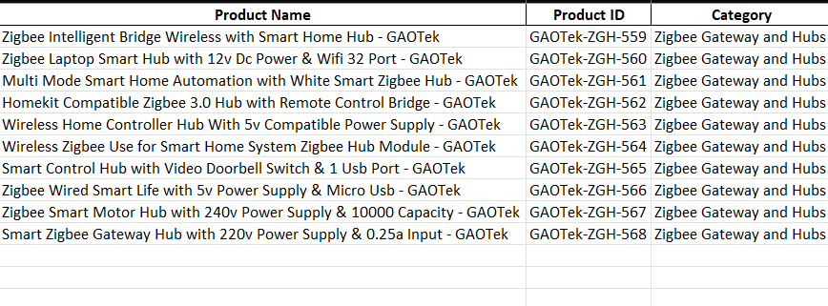
OUTPUT AS SIMPLIFIED FORMATTED TITLES AND DETAILS
PAGE 12

Slide 14
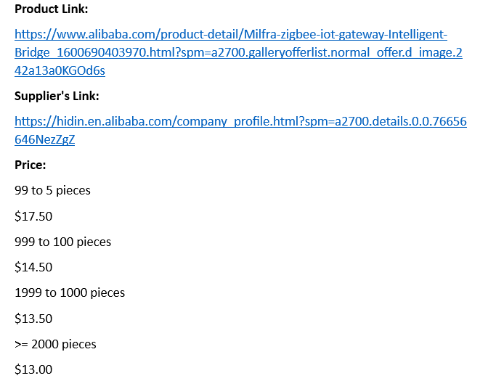
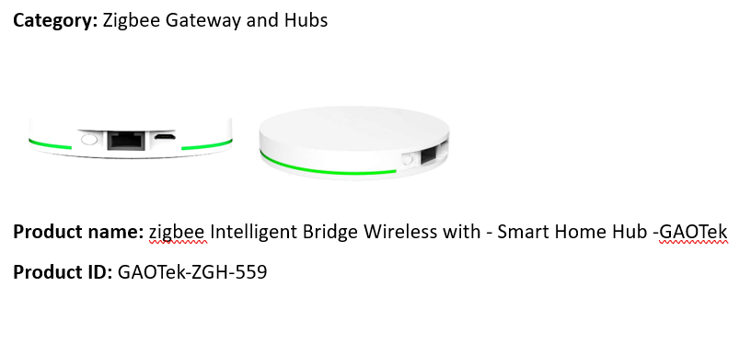
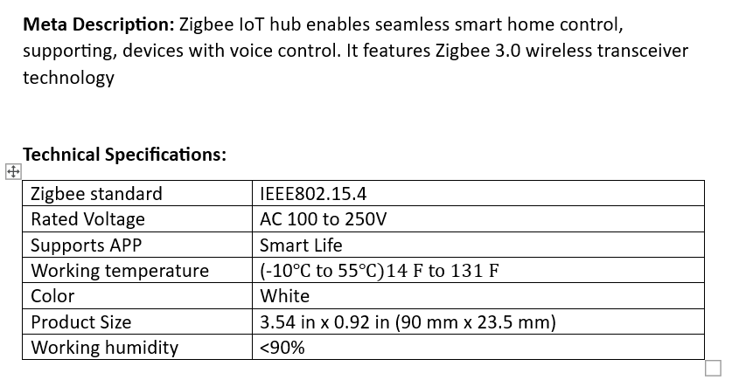
HOW IT WORKS?
Document Parsing:
Reads the document file to extract product information.
Data Formatting:
Applies specific rules for consistent data presentation.
Excel Output:
Creates Excel sheets with all formatted and linked data.
PAGE 13

Slide 15

WHY??
TIME EFFICIENCY:
AUTOMATES REPETITIVE TASKS.
CONSISTENCY:
REDUCES FORMATTING ERRORS.
SCALABILITY:
HANDLES MULTIPLE FILES, SUPPORTING LARGE-SCALE OPERATIONS.
PAGE 14

Slide 16

DRAW-BACKS
IT NEED UPDATION EVERYTIME COMPANY CHANGE ITS FORMAT OF WEBSITE
Continuous evaluation will be conducted to measure the impact of changes and gather feedback for further refinement.
PAGE 16

